Slide 1
Under the social microscope: characterizing human mobility
The Web Conf 2019 - San Francisco. CA. USA

Slide 2
What… and Why
Analysis of (big) mobility data has revealed distinctive statistical patterns, that can be used for:
validating mathematical models and simulation algorithms
training AI models for predictive tasks (monitoring of well-being, health, location prediction, etc.)

Slide 3
Human Mobility Measures
From movements data we can compute several measures that can be used to characterize the individual and collective mobility:
Individual measures: features related to the mobility patterns of a single individual
Collective measures: mobility patterns of an entire population of individuals

Slide 4
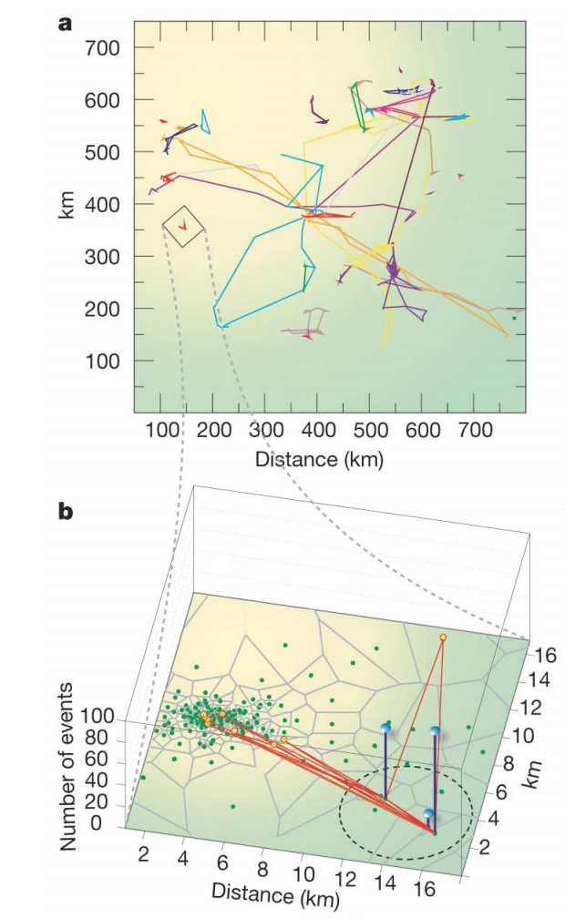

Jump length (or traveling distance)
The distance between two consecutive locations visited by an individual
For GPS data, we need to detect locations
Understanding individual human mobility patterns (Gonzalez et al., Nature, 2008).

Slide 5
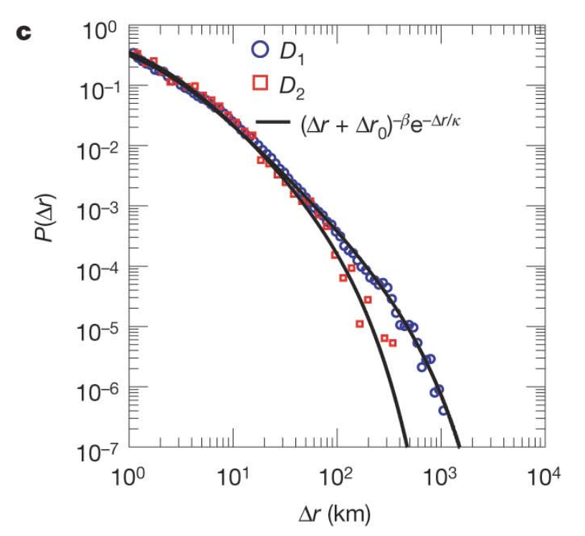

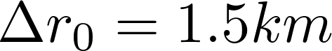

Jump length (or traveling distance)
Gonzalez et al., Understanding individual human mobility patterns, Nature, 2008.
D1: 100,000 for 6 months
D2: 200, 1 week, every 2h
Notes:
dire che è una scoperta importante perchè ci fa capire che la mobilità è invariante di scala, cioè non ha un valore tipico (come vedremo dopo)

Slide 6
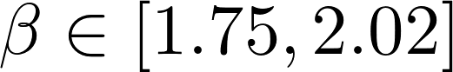
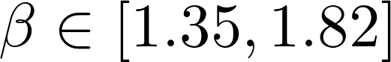

Jump length (or traveling distance)
CDRs
GPS
LBSNs
http://lauraalessandretti.weebly.com/plosmobilityreview.html

Slide 7
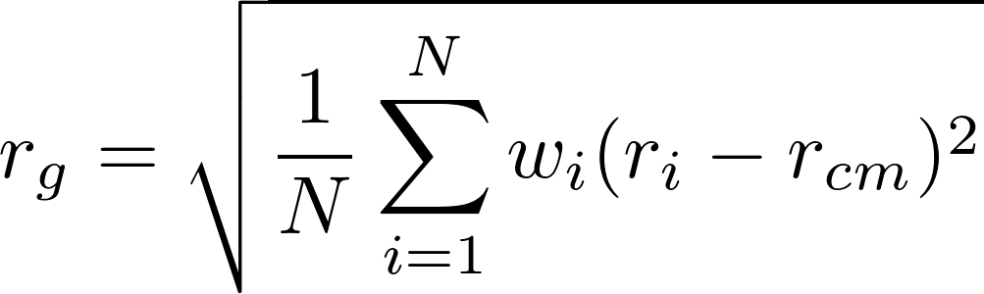
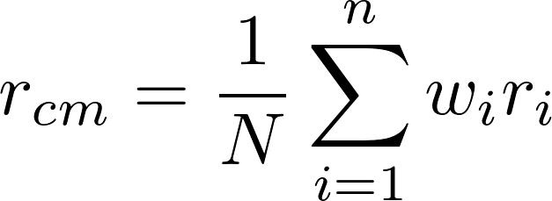
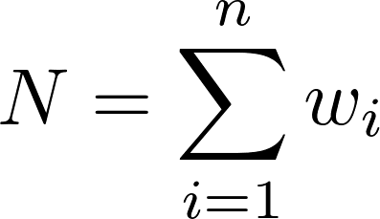
Radius of gyration
The characteristic distance traveled by an individual
For GPS data, we need to detect locations

Slide 8
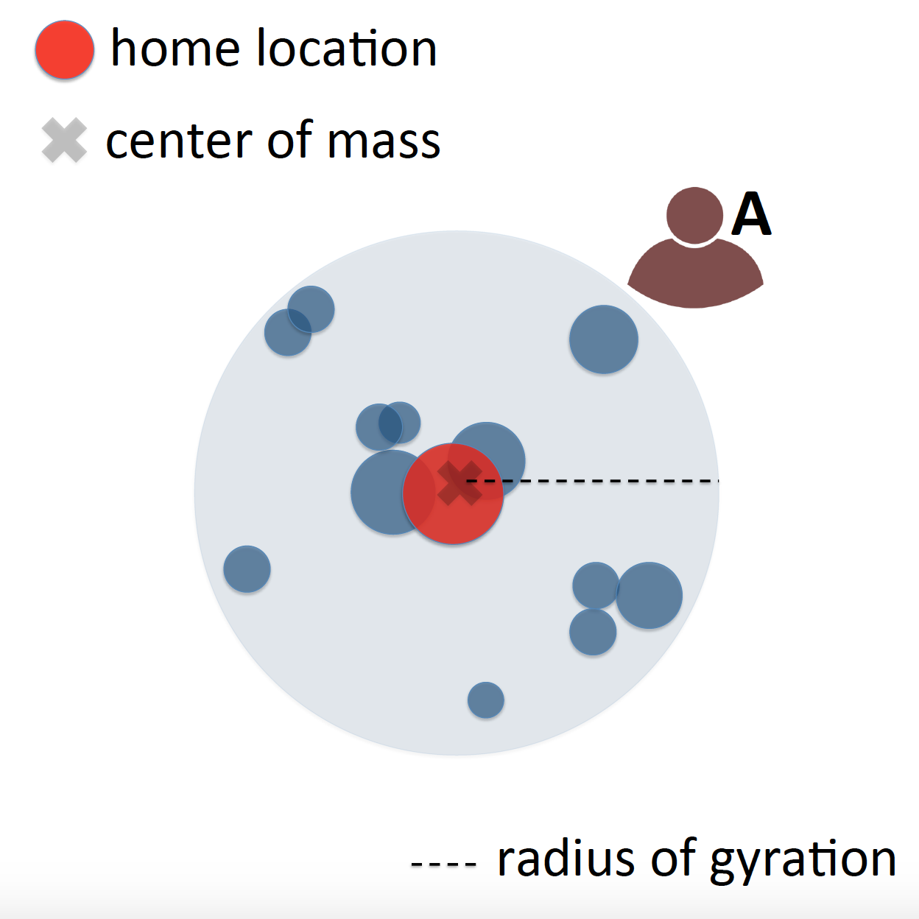
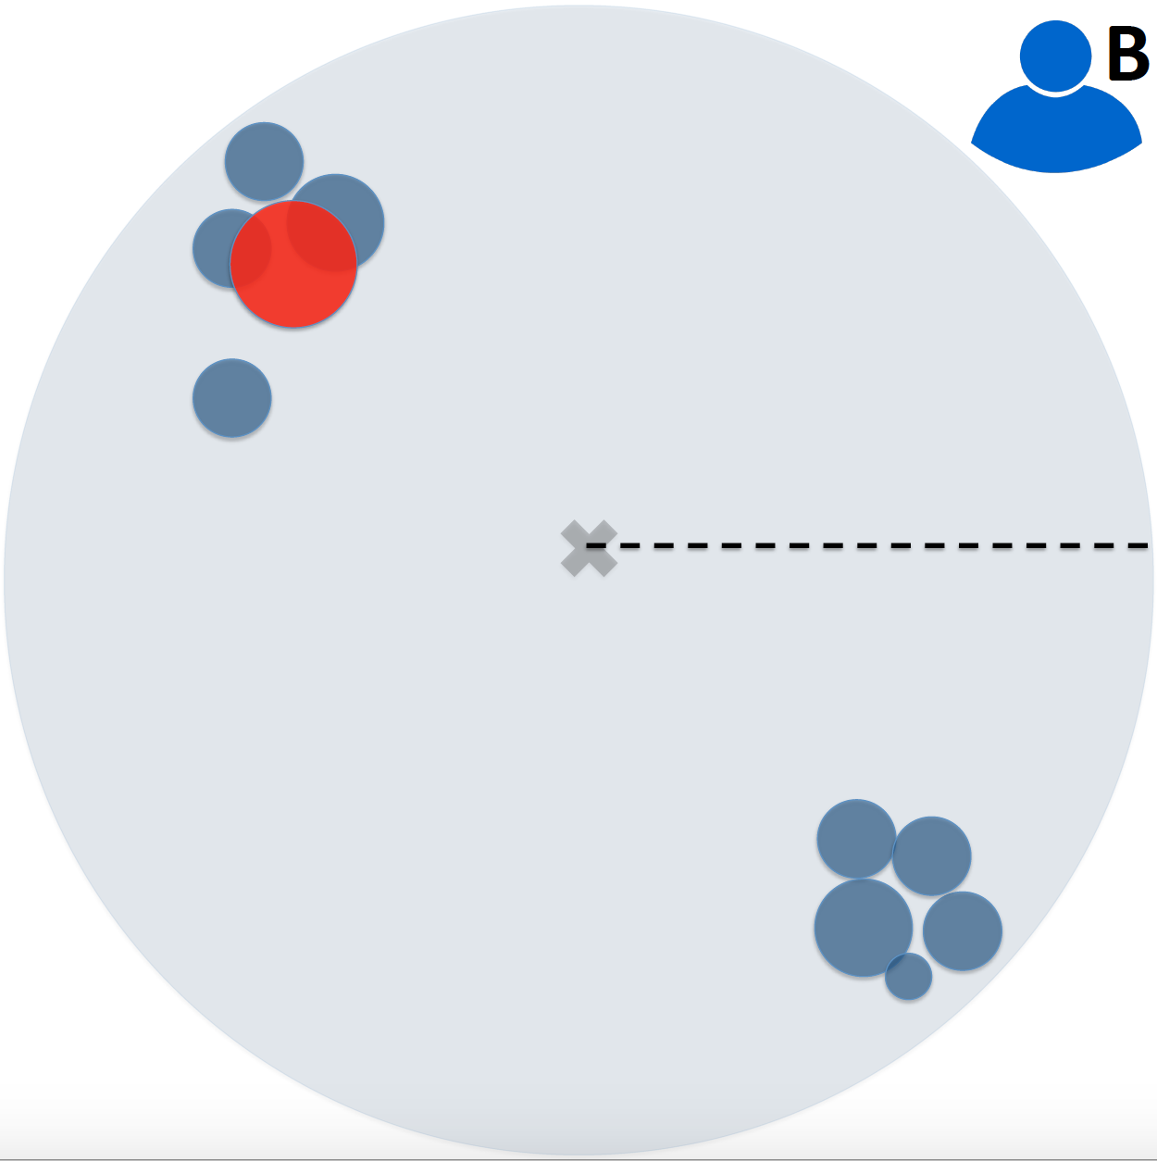
Radius of gyration
The characteristic distance traveled by an individual
An analytical framework to nowcast well-being with mobile phone data (Pappalardo et al., JDSA, 2016).

Slide 9
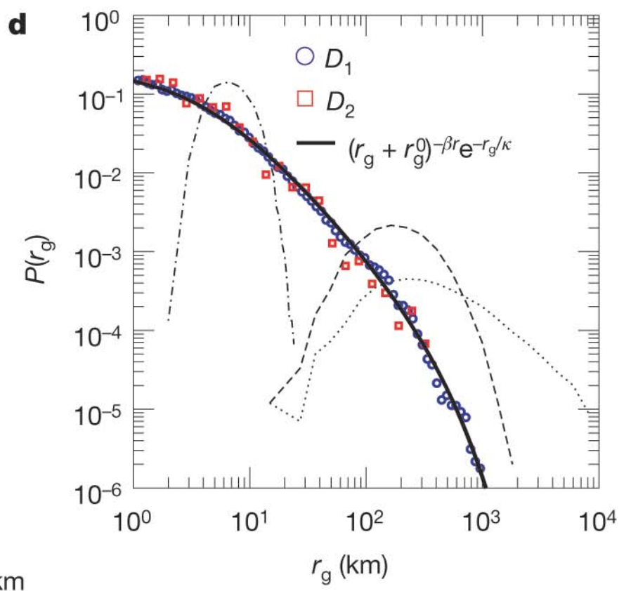
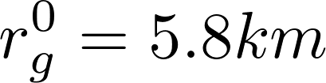


Radius of gyration
Gonzalez et al., Understanding individual human mobility patterns, Nature, 2008.

Slide 10
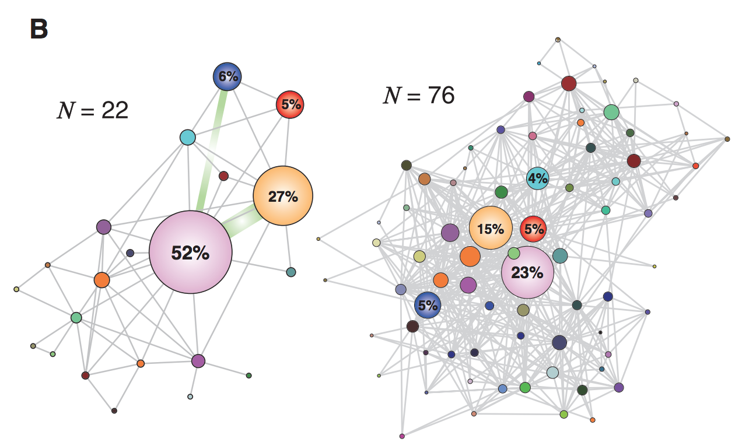
Individual Mobility Networks (Motifs)
IMN: a network describing the typical movements of an individual
Song et al., Limits of predictability in human mobility, Science, 2010.

Slide 11
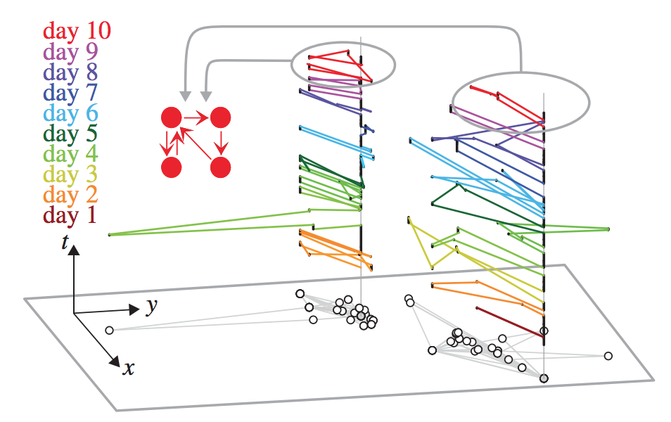
Individual Mobility Networks (Motifs)
Daily Motif: a frequent network describing the daily movements of an individual
Schneider et al., Unravelling individual daily mobility motifs, Journal of the Royal Society Interface, 2013.

Slide 12
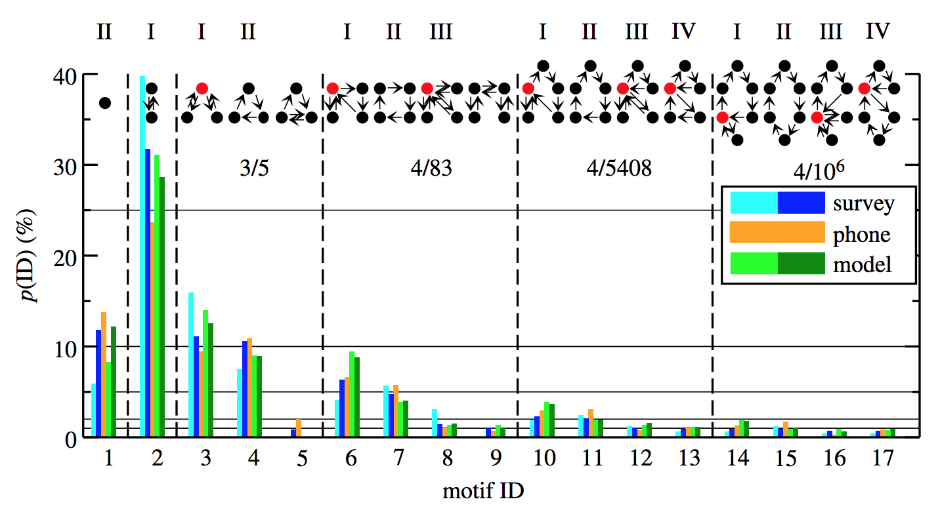
Individual Mobility Networks (Motifs)
17 daily motifs have been found in different mobility data sources
Schneider et al., Unravelling individual daily mobility motifs, Journal of the Royal Society Interface, 2013.

Slide 13
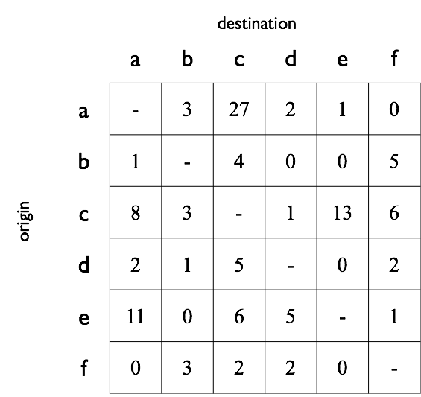
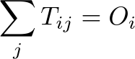
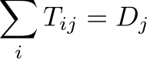
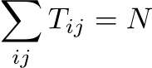
OD matrix
total out-flow from i
total in-flow to j
total flow
(self-loops are usually not considered)

Slide 14
Human Mobility and Machine Learning
Human mobility patterns, both at individual and collective level, can be used for several predictive and analysis tasks:
Human Behaviour Prediction
Car Crash Prediction
Influenza like-symptoms prediction Are you getting sick? Predicting influenza-like symptoms by using human mobility behaviors (Barlacchi et al.)
Human Mobility for Social Good
Predicting socio-economics behaviours from mobility data
Predicting poverty and wealth from mobile phone metadata (Blumenstock J. et al.)
Notes:
Focus on movements prediction - more interesting models - and then review some applications

